Slide 1
S. Elsaadawy(GU), J. Kralj(NIST) , S. Servetas( NIST)
Characterization of antimicrobial resistance profiles in the microbiomes of vegetarian and omnivore diets
Acknowledge: Dr. Ross(GU), S. Jackson(NIST), I. Keenum (Michigan Tech)

Slide 2
Overview of Antimicrobial Resistance (AMR)
(WHO) has identified AMR as one of the top 10 global public health threats facing humanity
What is AMR?
What is AMR global health impact?
What is the Importance of tracking AMR? (global health security)

Slide 3
The challenge on detecting (amr) genes
Complexity of Bacterial Genomes
Horizontal Gene Transfer
Limited Access to Comprehensive Databases
Technical and Resource Limitations

Slide 4
Data
1- collection of samples
2- Data sequencing and genome assembled
3- Data output

Slide 5
questions
1- which organisms have AMR genes from each diet?
2- What is the composition of AMR marker-containing microbiome in each diet ?
3- What classes of AMR are present ?
4- AMR positive species specific to each diet?
5-Are there a common organisms with ARM genes between the two diets?

Slide 6
METHODS

Slide 7
RESFINDER
What is RESFINDER?
Comprehensive Database
Regular updates database
Global Accessibility
User-Friendly Interface

Slide 8

Resfinder

Slide 9
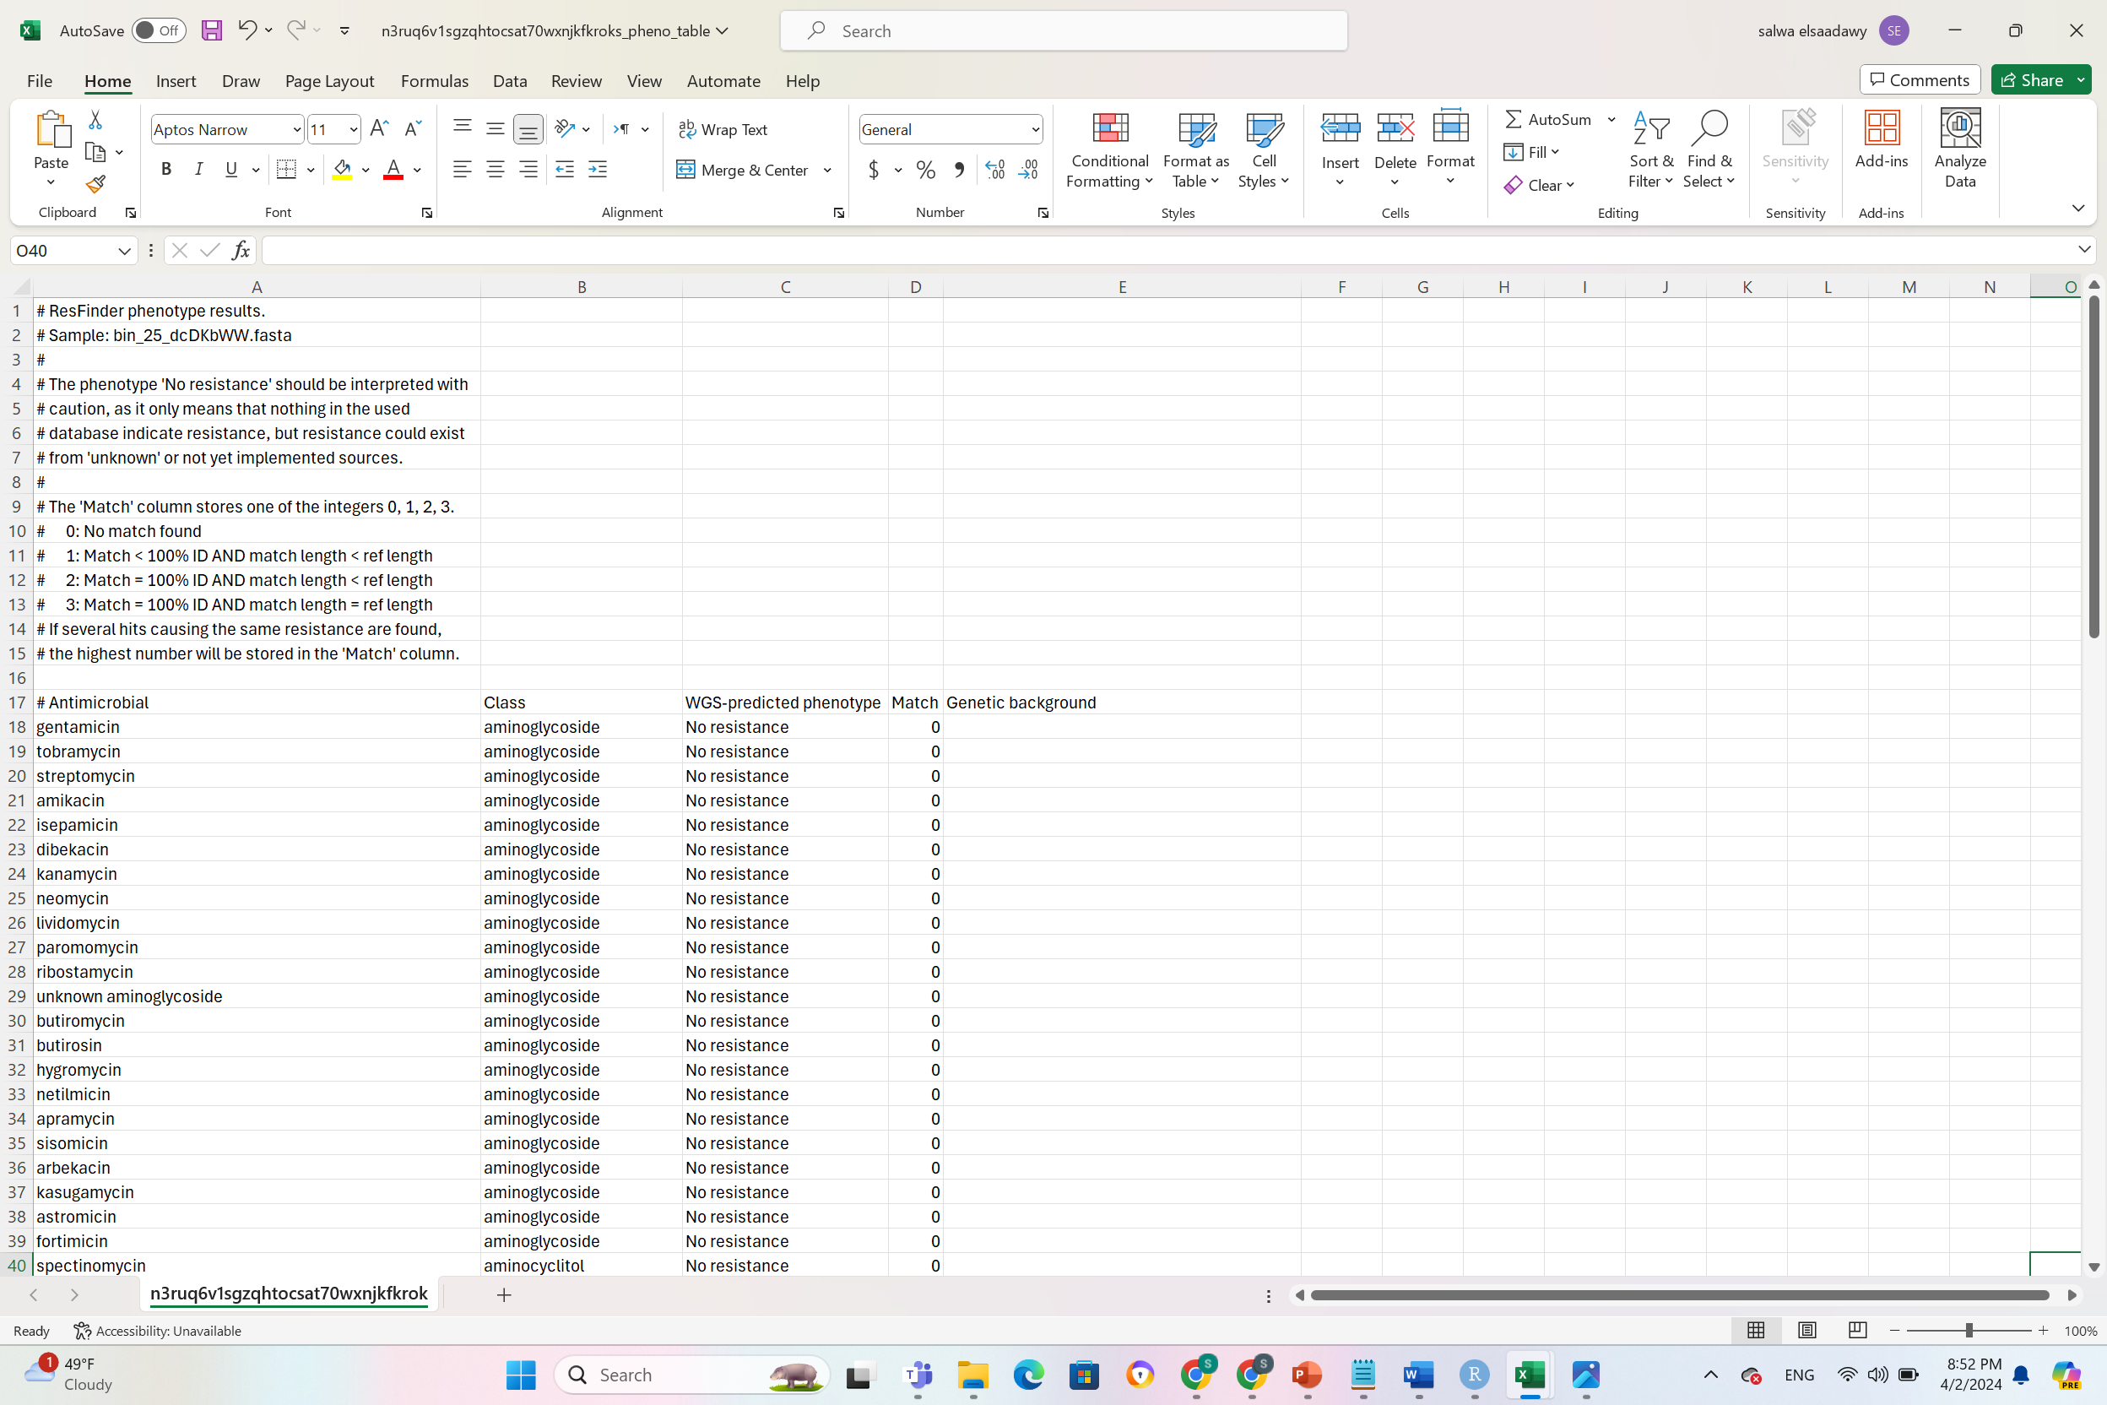
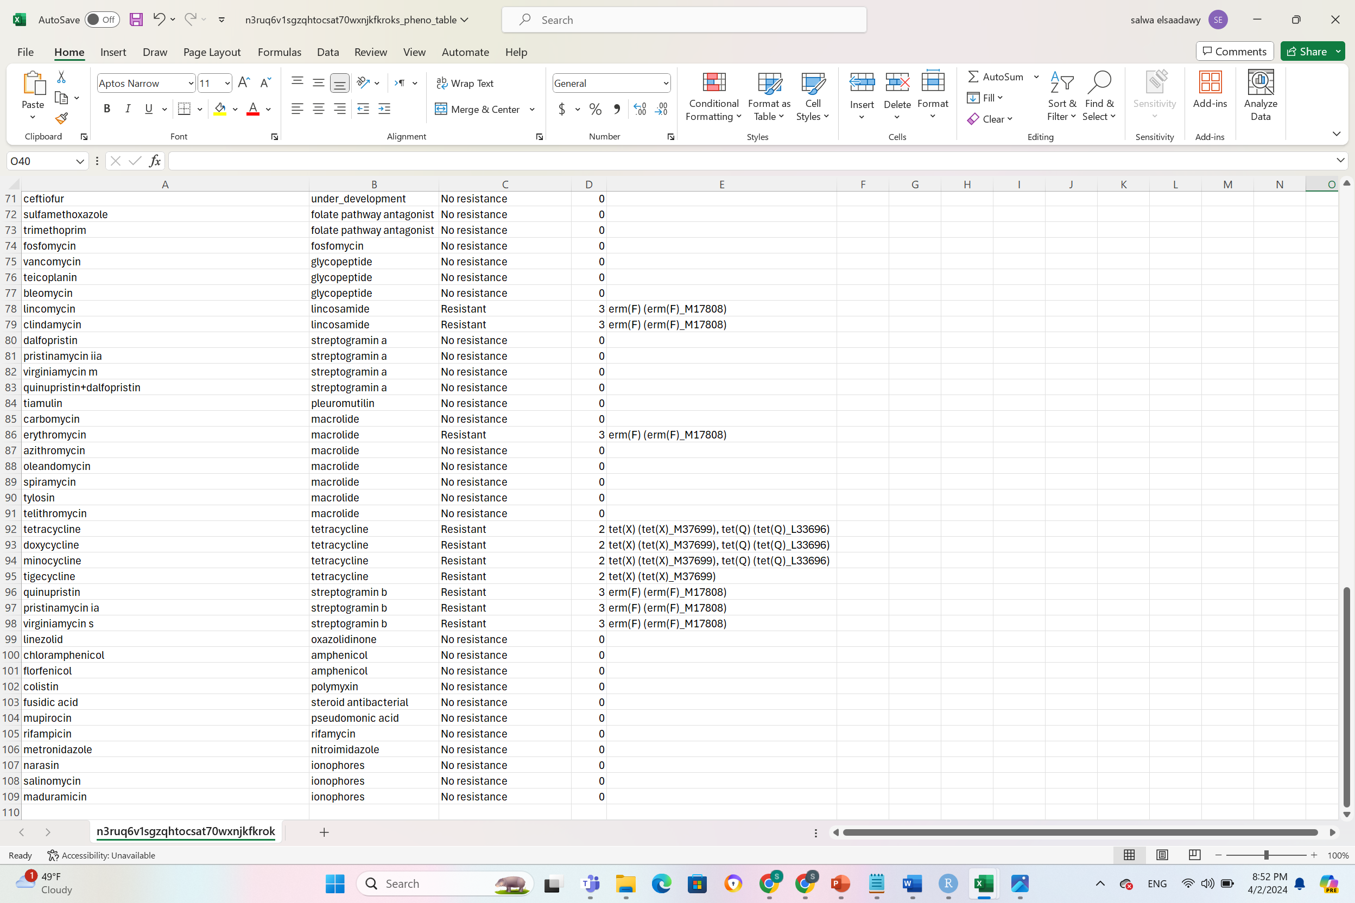
Example of the output(2 files)

Slide 10
Workflow pipeline

Slide 11
R studio workflow
file
Filtration
Visualization

Slide 12
Question one
which organisms have AMR genes from each diet?

Slide 13
OMNIVORE
VEGETARIAN
564 organisms
364 organism
DETECTION
DETECTION
163 organisms
(28.90%)
78 organisms
(21.43%)

Slide 14
Question two
What is the composition of AMR marker-containing microbiome in each diet ?

Slide 15
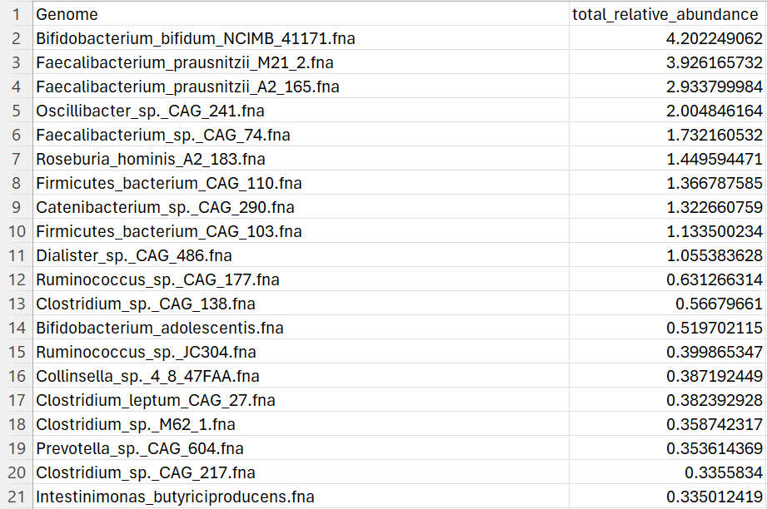
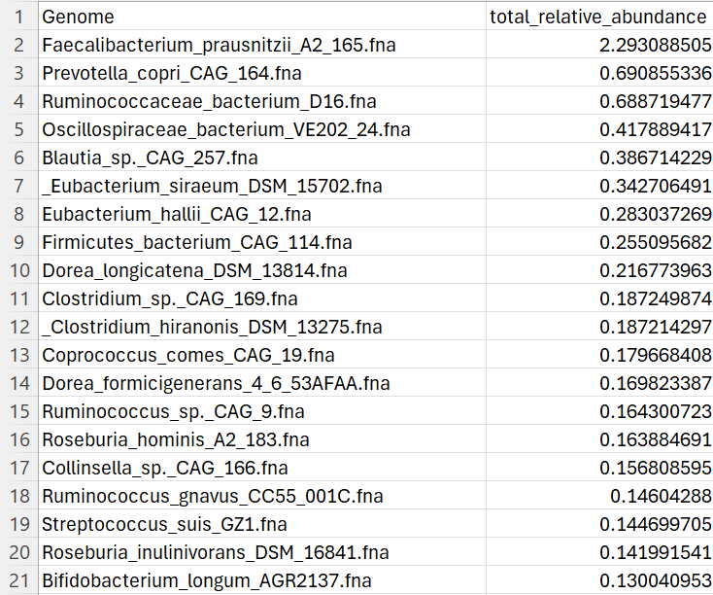
Top 20 AMR organisms In Omnivorous Diet
top 20 AMR Organisms In Vegetarian Diet
The total relative abundance sum of the top 20 AMR organisms In Omnivore Diet
The total relative abundance sum of the top 20 AMR organisms In Vegetarian Diet
25.39
7.34

Slide 16
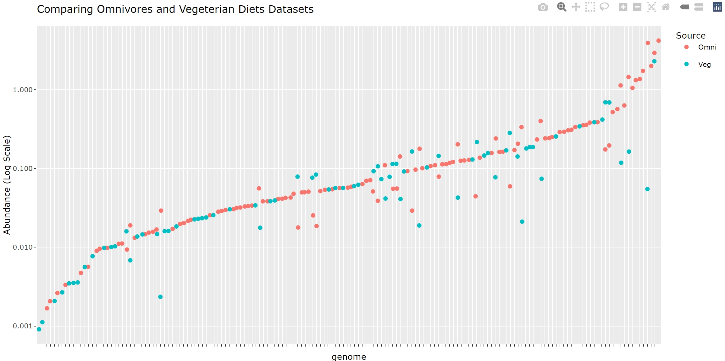
Overlook Of the data
file:///C:/NIST_internship/Final_prsentation/both_data_combined_realtiveabundance/both_data_new.html

Slide 17
Question Three
What classes of AMR are present ?

Slide 18
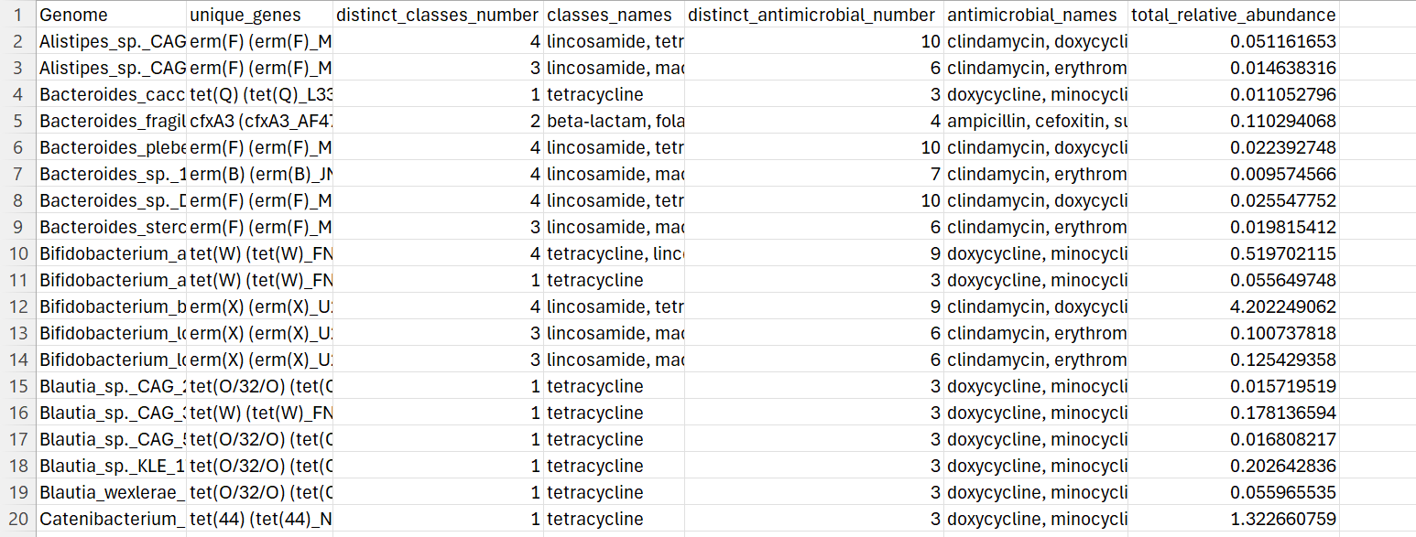
Summary Resistance Profiles in omnivores Microbiomes

Slide 19
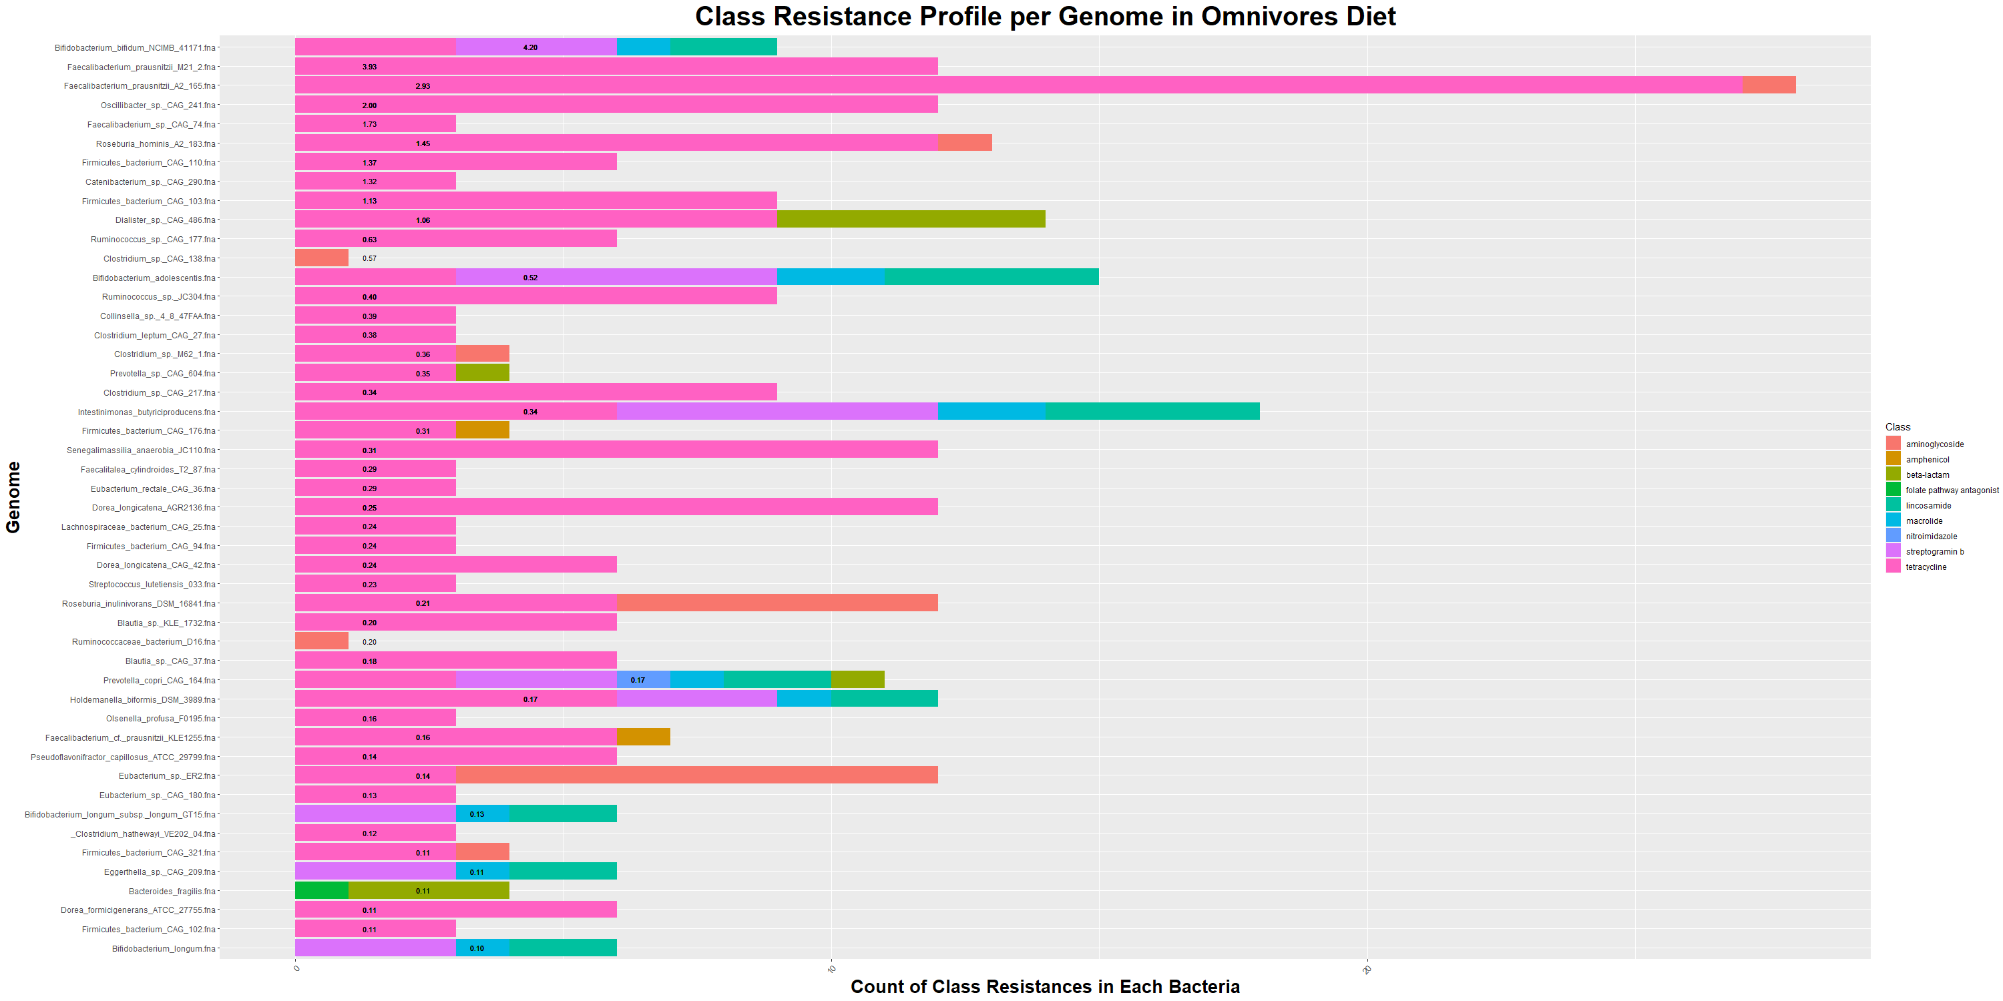
Exploring Class Resistance Profiles in omnivores diet Microbiomes

Slide 20
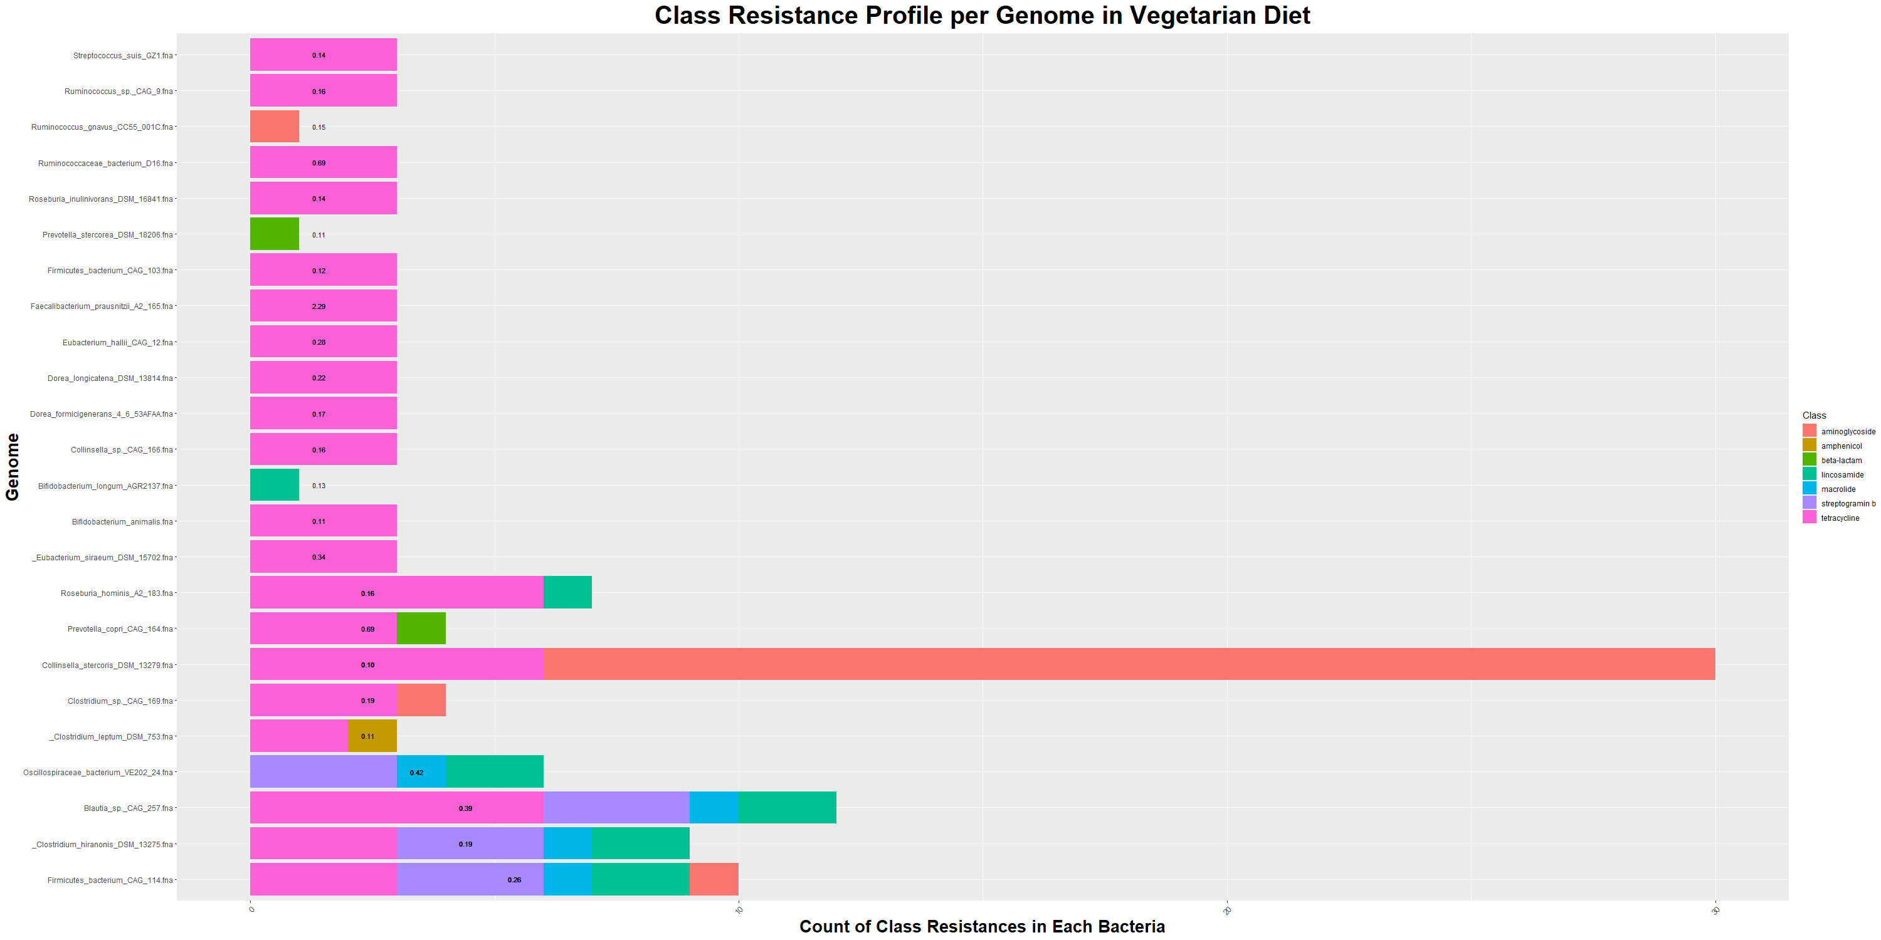
Exploring Class Resistance Profiles in vegetarian diet Microbiomes

Slide 21
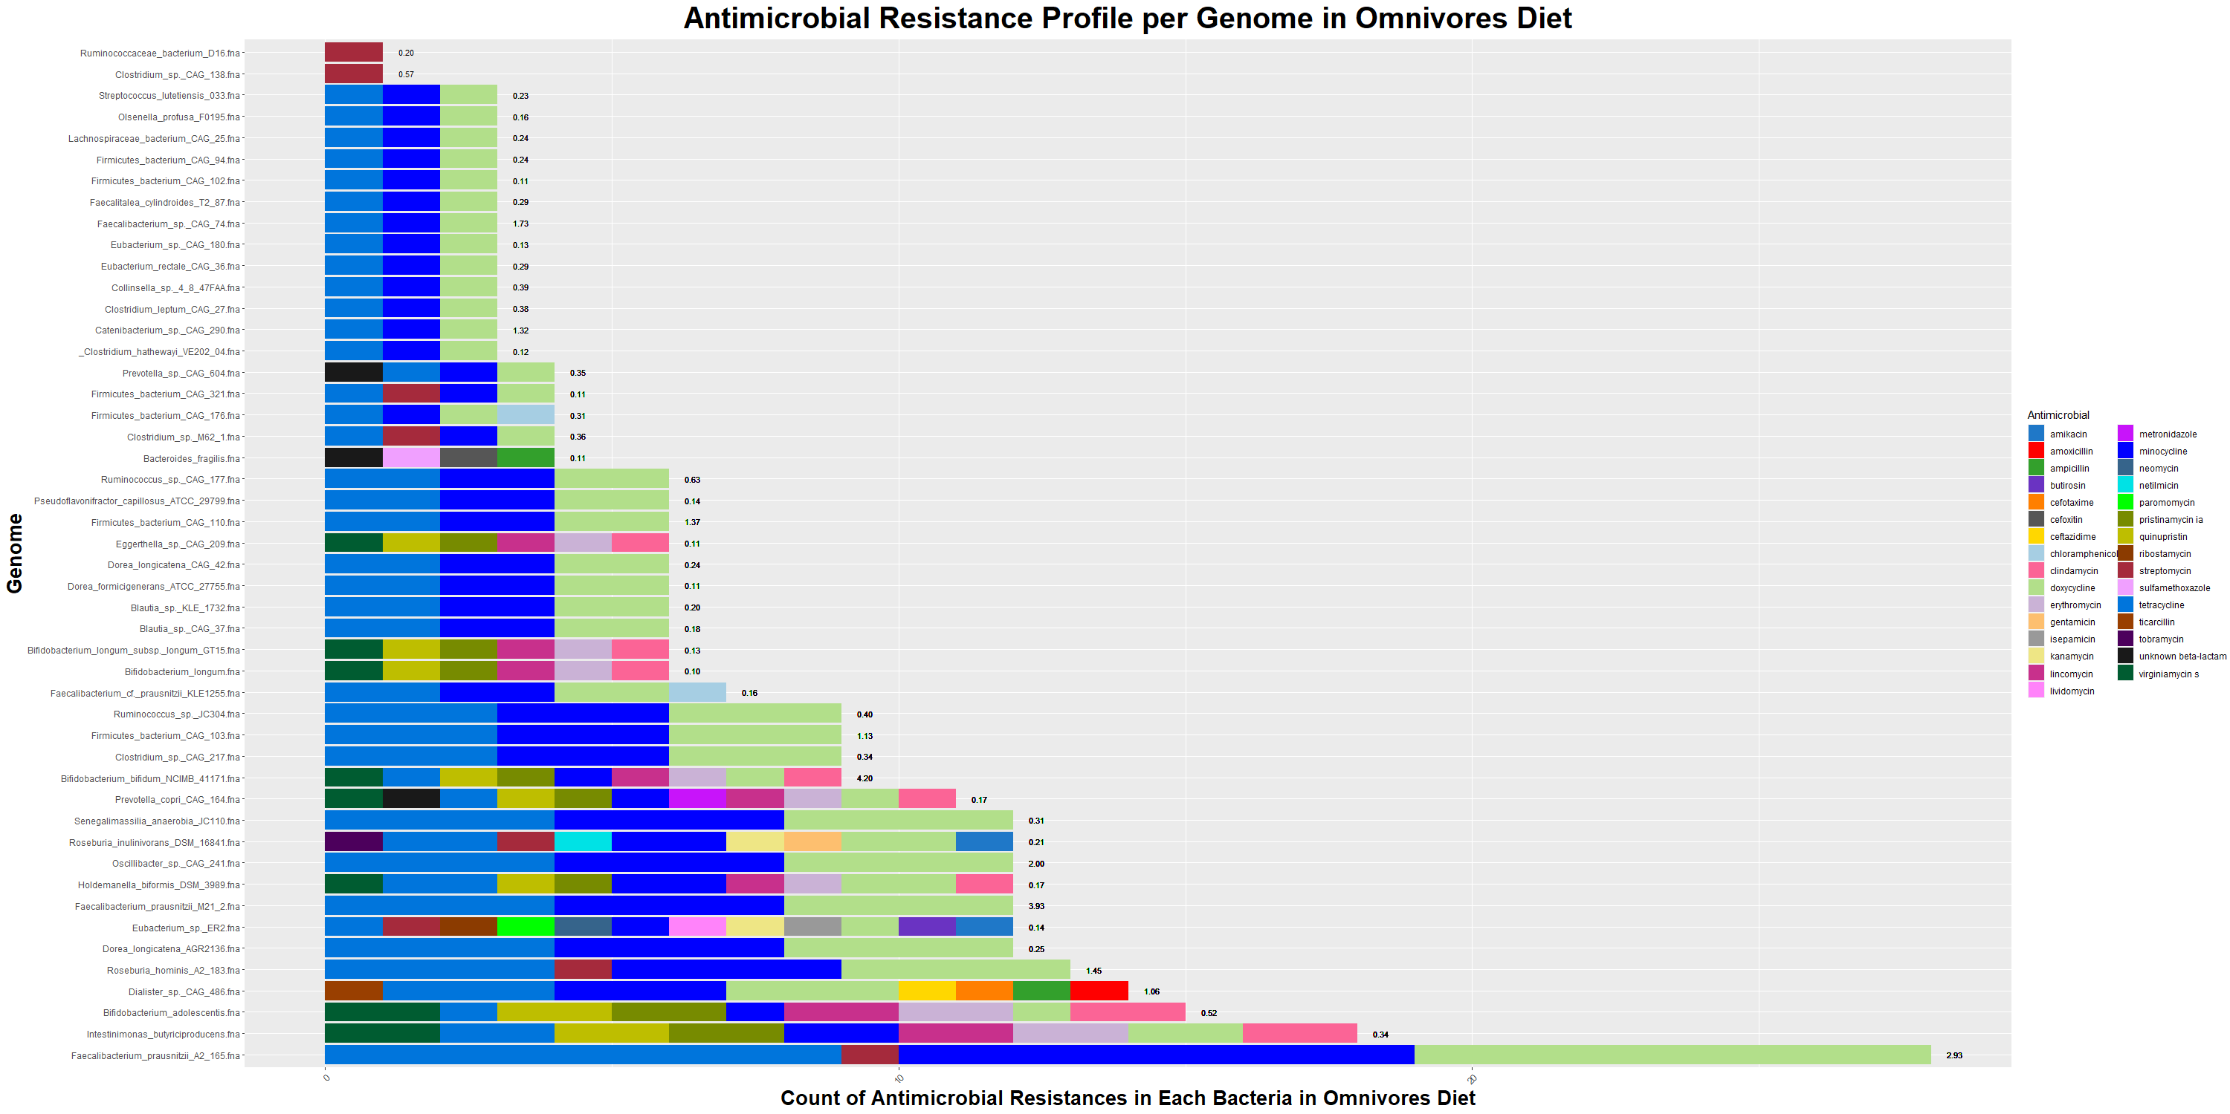
Exploring Antimicrobial Resistance Profiles in omnivores diet Microbiomes

Slide 22
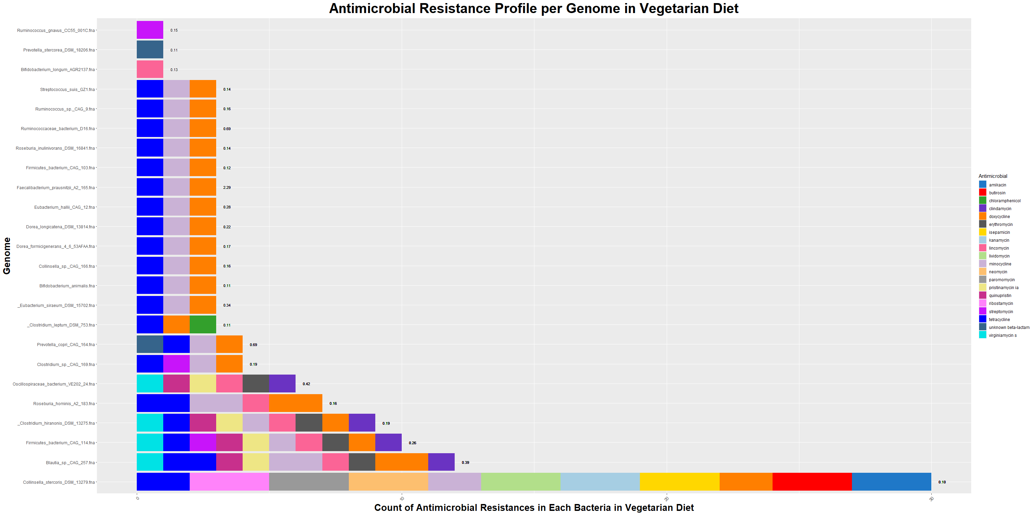
Exploring Antimicrobial Resistance Profiles in vegetarian diet Microbiomes

Slide 23
Question four
AMR positive species specific to each diet?

Slide 24
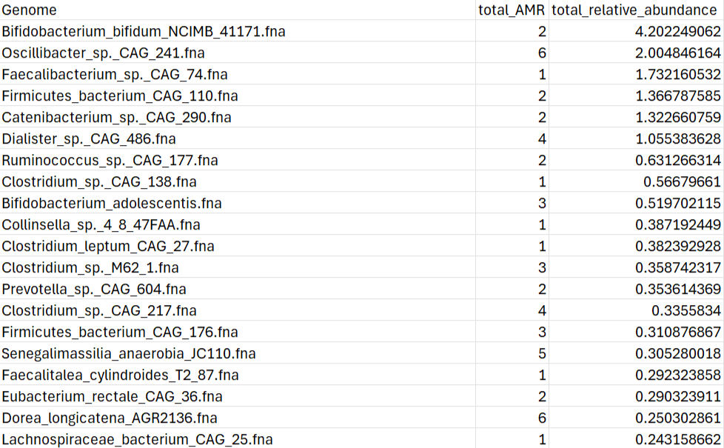
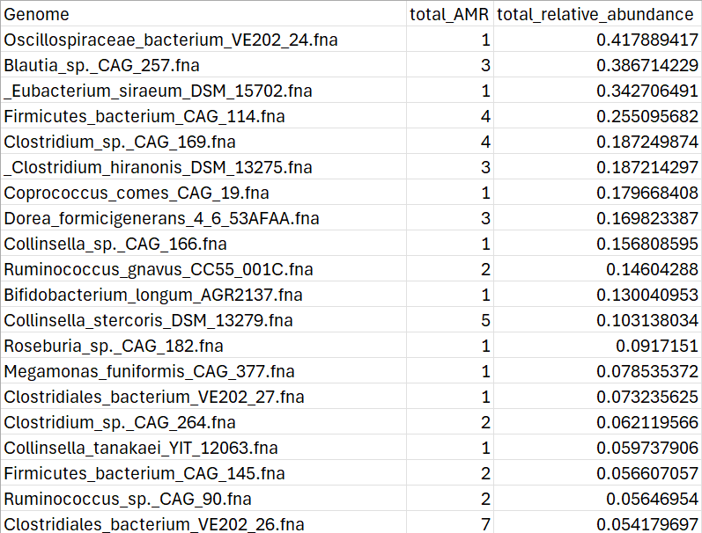
AMR Bacteria present in omnivores diet only
AMR BACTERIA PRESENT IN VEGETARIAN DIET ONLY
The sum of total relative abundance for the top 20 AMR organisms exclusive to Omnivore Diet
The sum of total relative abundance for the top 20 AMR organisms exclusive to vegetarian Diet
16.9
3.19

Slide 25
Question five
Are there a common organisms with ARM genes between the two diets?

Slide 26
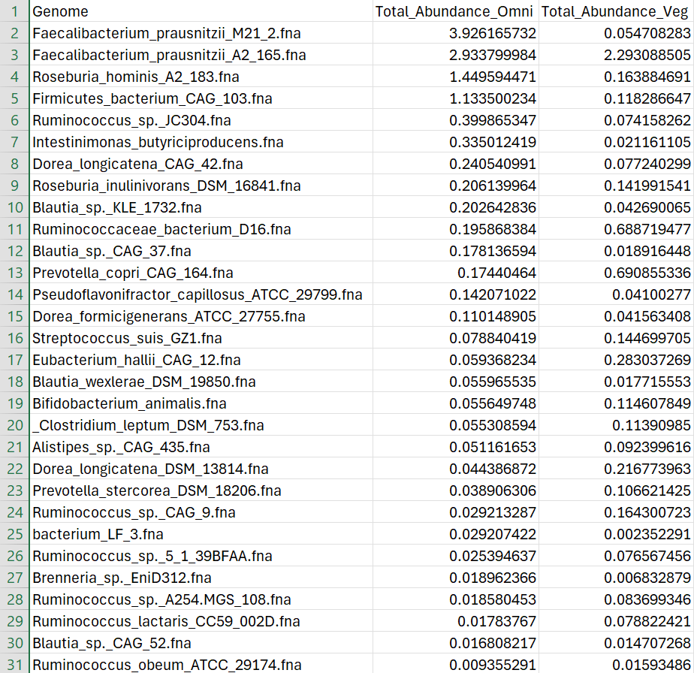
Common microbiome AMR genes In omnivore Vs vegetarian diet
The sum of total relative abundance for common AMR organisms for each diet
12.2
6

Slide 27
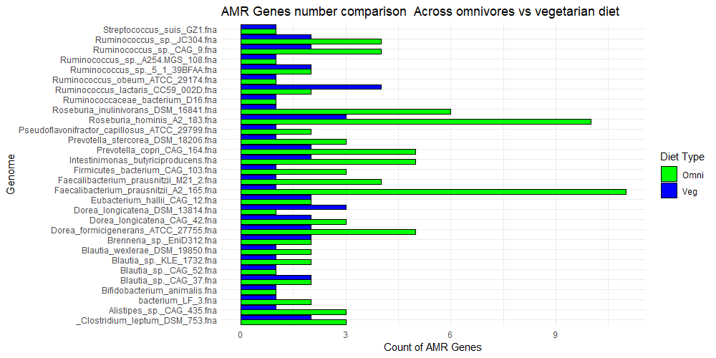
Common microbiome AMR Microbes In omnivore Vs vegetarian diet

Slide 28
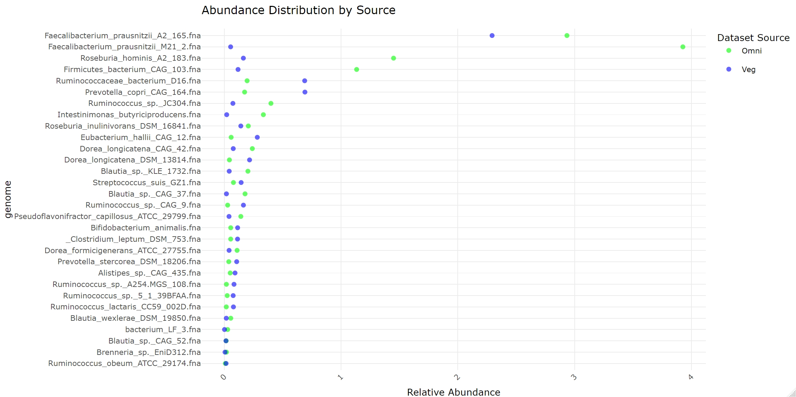
Abundance In omnivore Vs vegetarian diet in common AMR positive organisms
file:///C:/NIST_internship/common_abundance.html

Slide 29
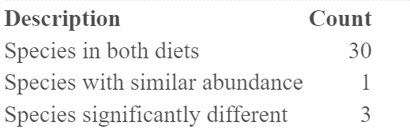
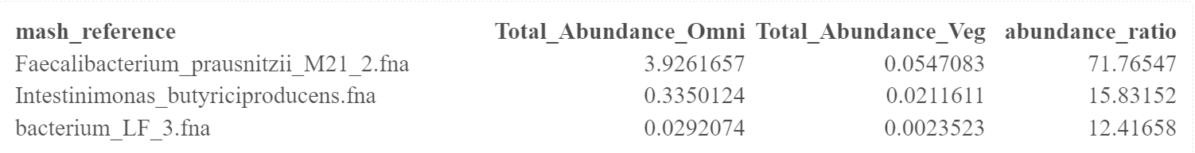
COMMON MICROBIOME SUMMARY
SPECIES SIGNIFICANTLY DIDDERENT(MORE THAN 10FOLD CHANGE)
Species with similar abundance

Slide 30
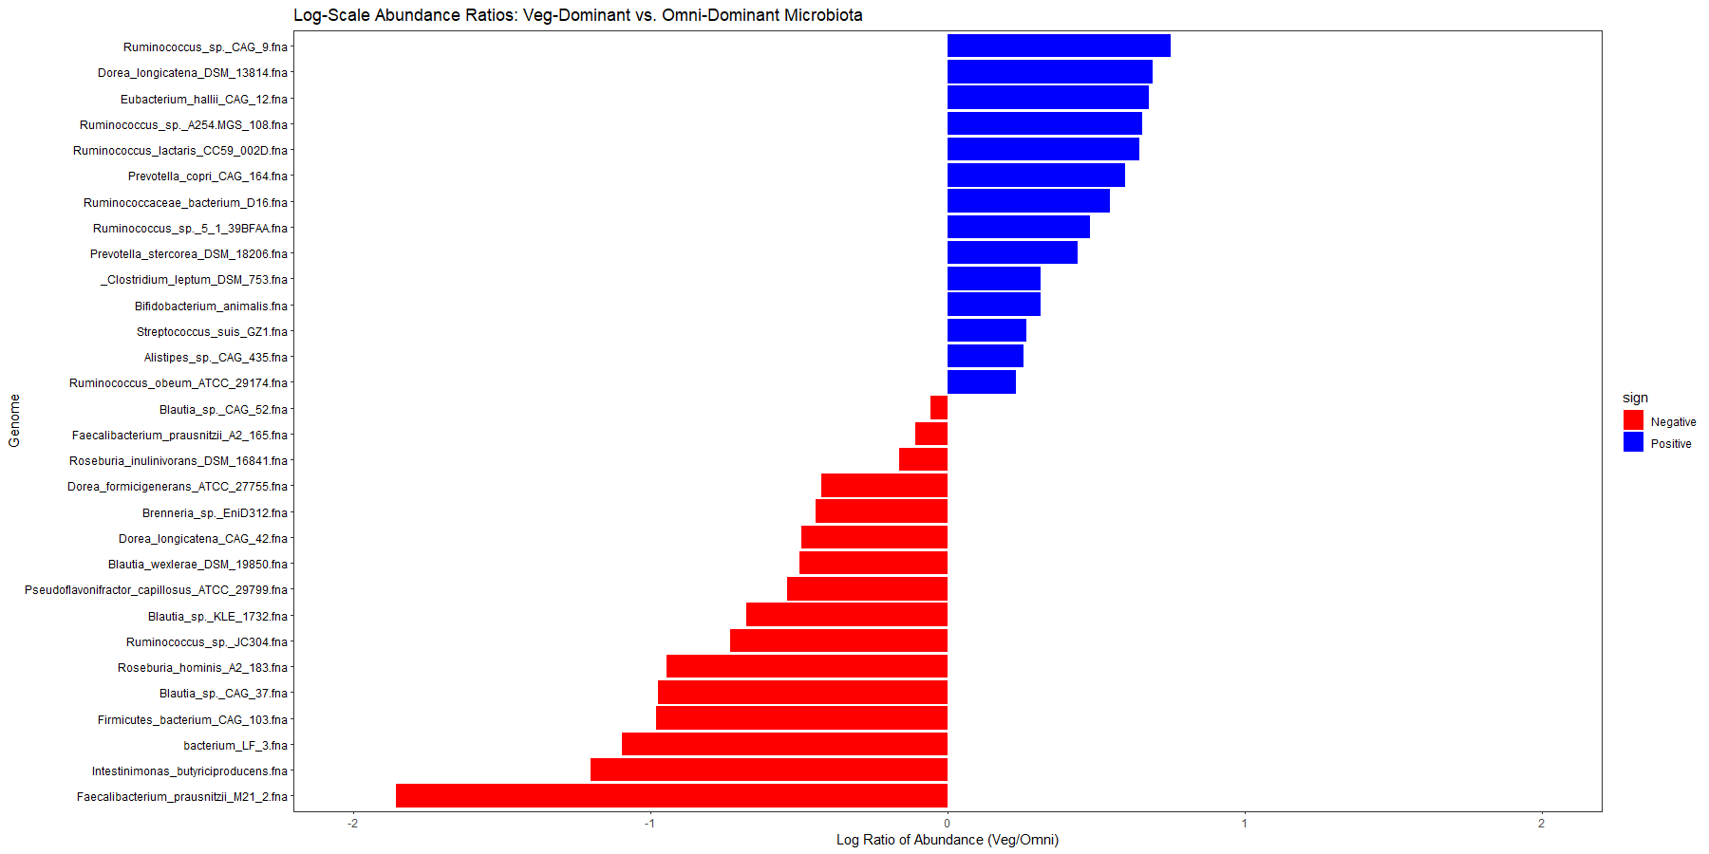
Log-Scale Analysis of Microbiome Variance by Diet Type

Slide 31
Conclusion
Relative abundance for AMR organisms higher in omnivorous diet than vegetarian diet
Total AMR genes higher in omnivorous diet than vegetarian diet
predominant resistance in both diet is tetracycline Resistance
Looking in individual resistance of antibiotics, the organism may be resistant to one antibiotic not the other from the same class
We were able to look at AMR bacteria that is unique and common

Slide 32
THANK YOU
Salwa Elsaadawy
sme76@georgetown.edu

